Slide 1
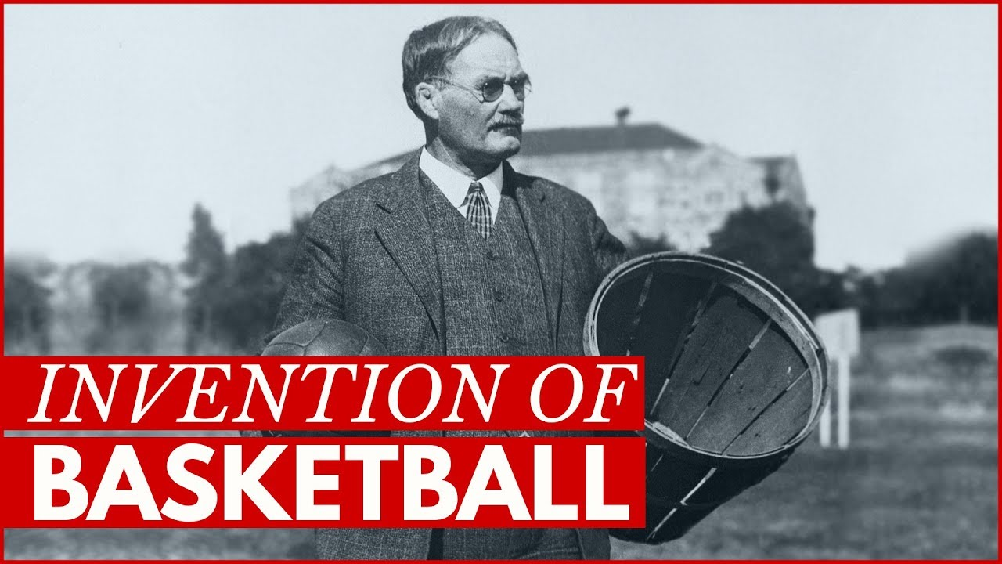
JAmes Naismith
A basketball and teaching sensation

Slide 2
When he was born
James Naismith was born on November 6th in1861 in Almonte, Ontario.

Slide 3
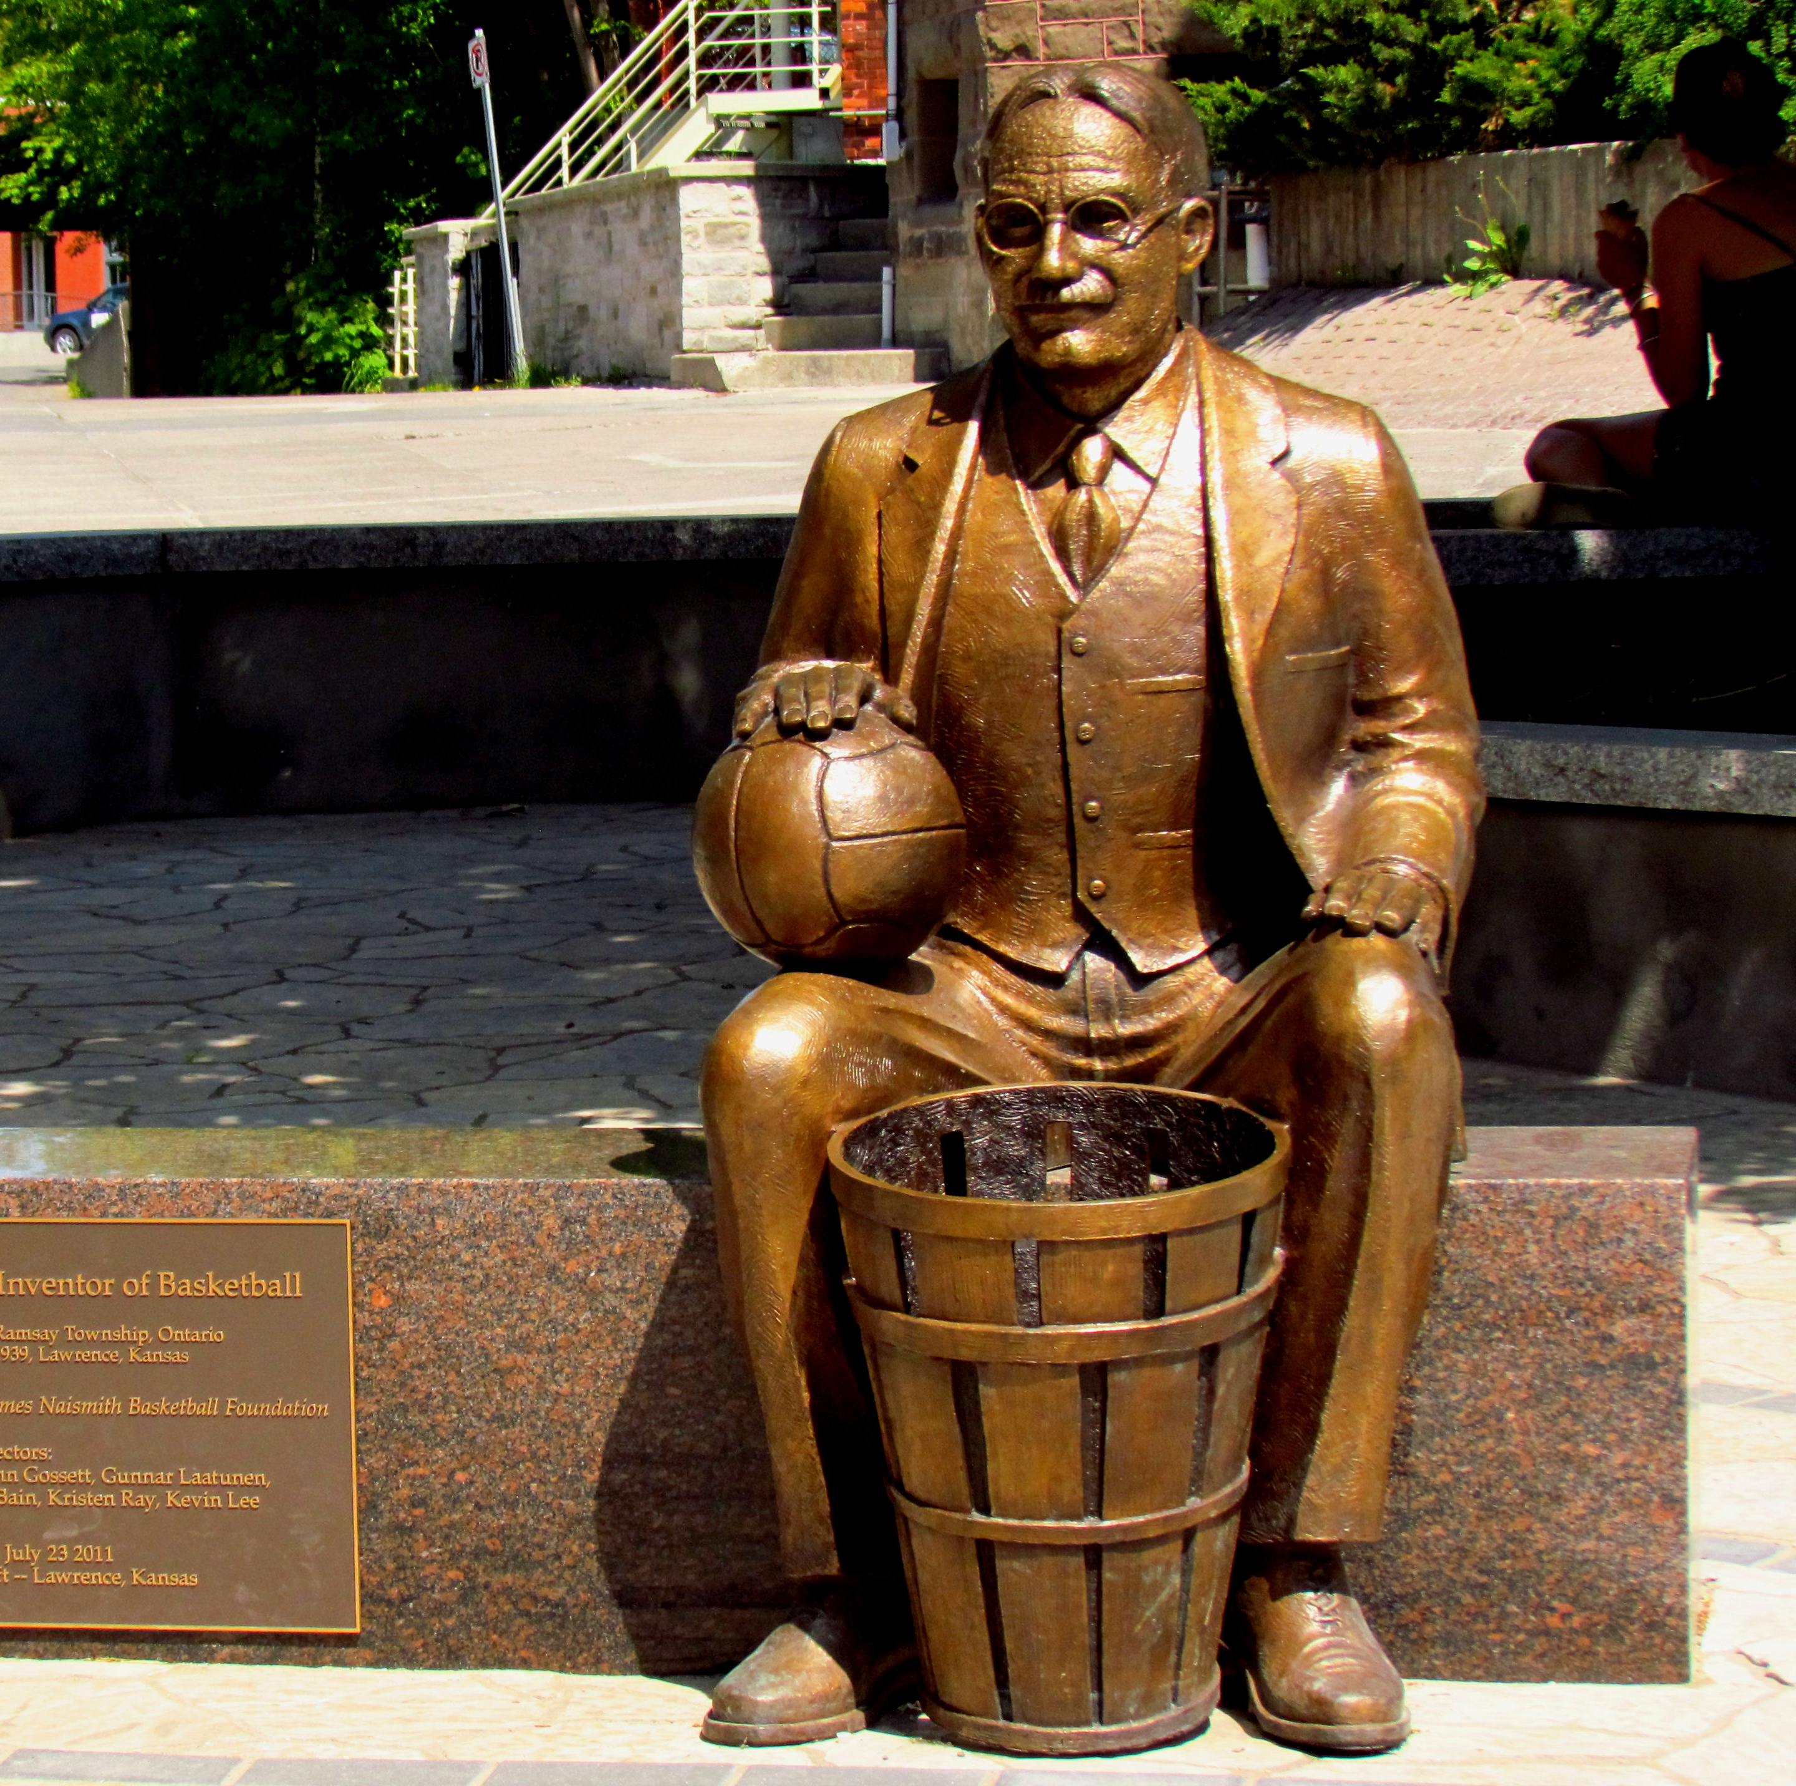
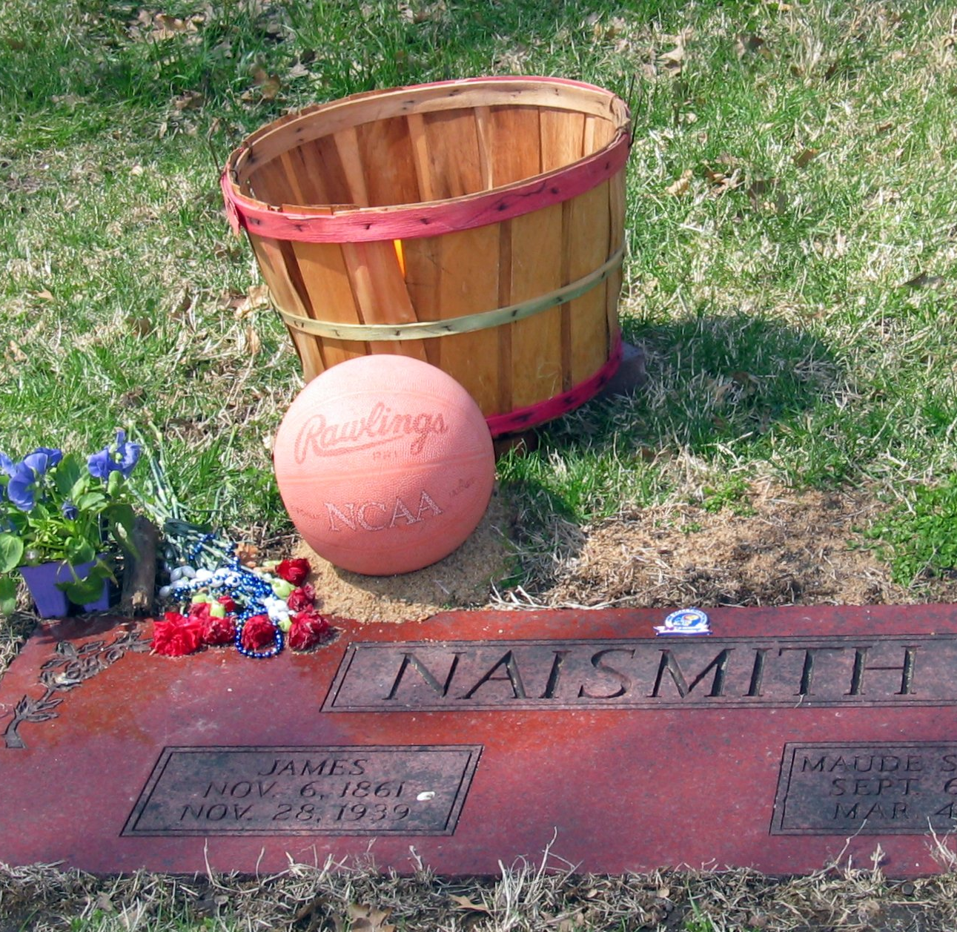
When he died
James Naismith died on November 28th in the year 1939 due to a hemorrhagic stroke 22 days after his 78th birthday.

Slide 4
What he did for Canada
James Naismith is best known to be the inventor of the game basketball.
He was also the first full-time athletics instructor at McGill University and established the basketball program at the University of Kansas and worked and lived there for 41 years until his death.
Look I got a video...
https://www.youtube.com/watch?v=xiJJIacdF-E

Slide 5
When and why?
James Naismith invented basketball because they needed a sport to play indoors because it was too cold to play baseball or football outside.
It was first used in 1891 at the YMCA training school in Springfield, Massachusetts.
This Photo by Unknown author is licensed under CC BY-SA-NC.

Slide 6
How he created basketball
James Naismith created basketball by throwing balls into peach baskets.
He did this by remembering playing "duck on a rock" as a child.
For people who don’t know, "duck on a rock" is a game where people throw rocks at a target placed on a tree stump or a boulder.

Slide 7
Famous words of wisdom
"I felt a crucial moment in my life as I felt success or failure of my attempt to hold the interest of the class and devise a new game." - James Naismith.
"Be strong in body, clean in mind, lofty in ideals."-James Naismith
"The invention of basketball was not an accident. Those boys simply would not play "drop the handkerchief."-James Naismith.

Slide 8
Family biography
Margaret young –mother
John Naismith –father
Annie Naismith –sister
Robbie Naismith –brother
Maude Ann –daughter
Margaret Mason –daughter
Helen Carolyn –daughter
Maude Evelyn Sherman- wife m. 1834-1937
Florence B. Kincaid –second wife m. 1939-1939

Slide 9
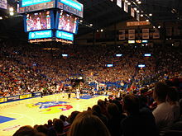
Why I think James Naismith should be on the $5 dollar bill
I think James Naismith should be on the $5 dollar bill because he didn’t just give up and go home, he literally created a big part of sports history for the whole world. he was and still is a leader, a perseverer, a teacher, a coach, a role model. He also was very creative. Basketball wouldn’t be real if he gave up; we would be stuck playing "duck on a rock."

Slide 10
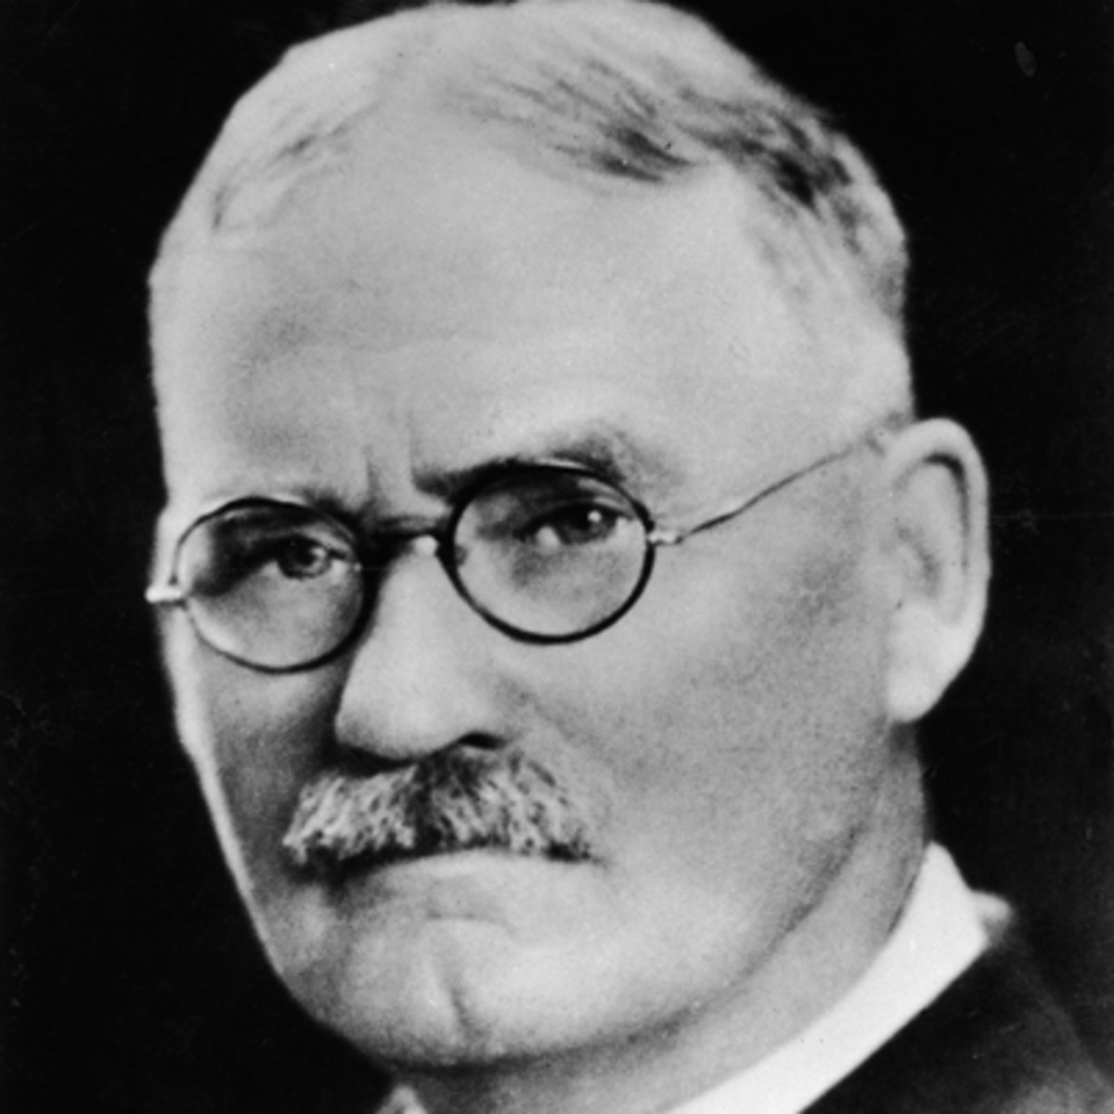
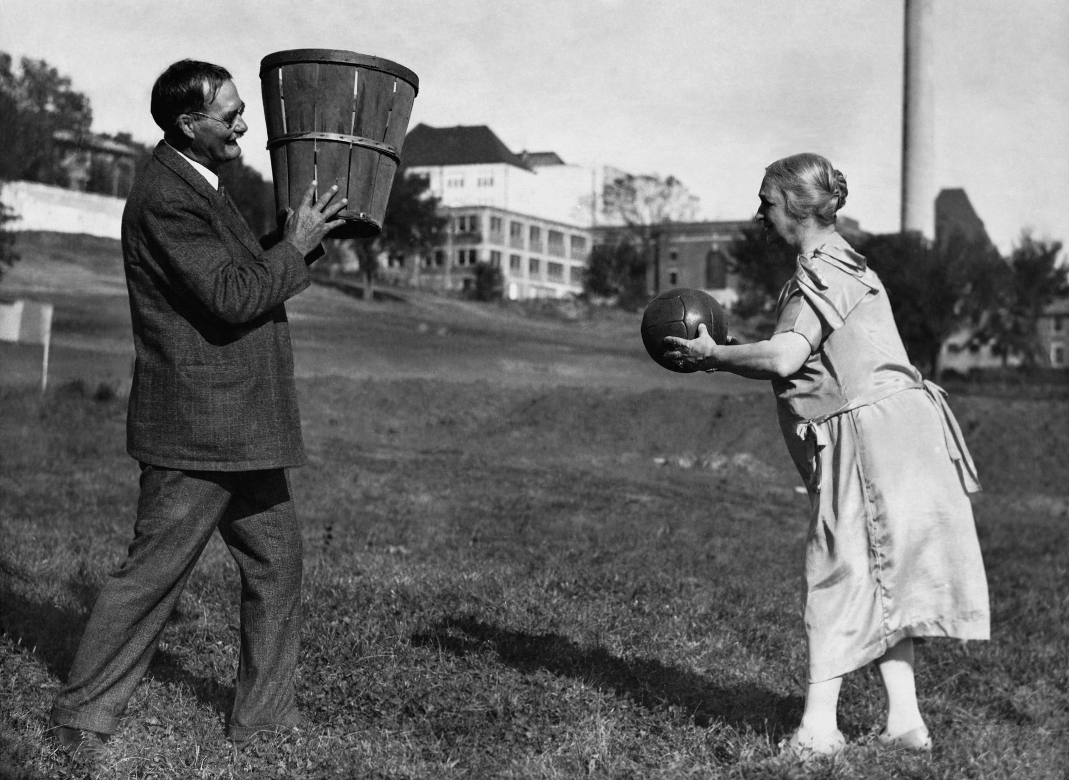
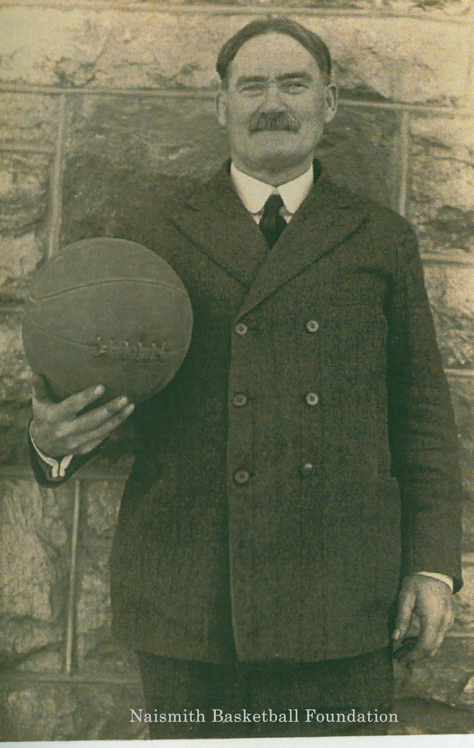
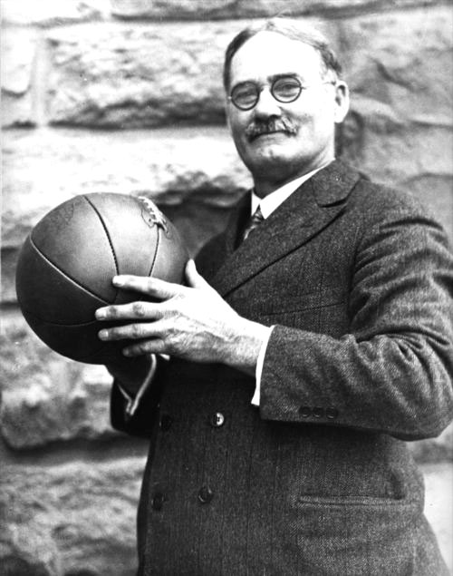
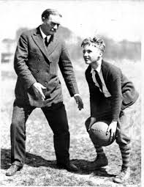
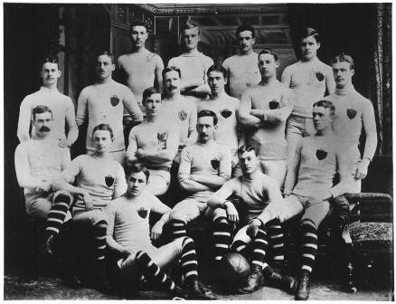
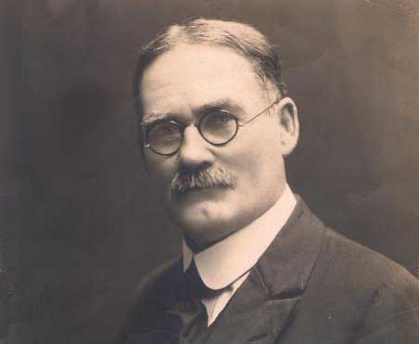
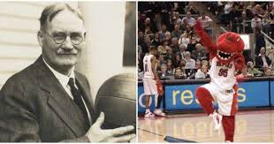
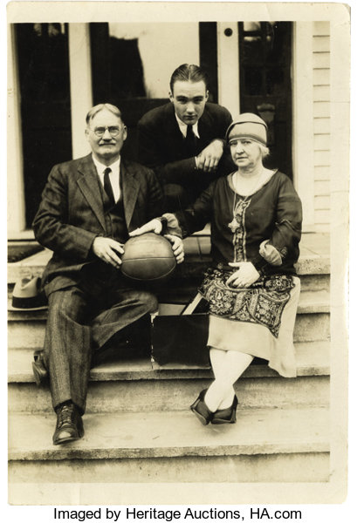
The end

